Slide 1
Data-Driven Growth Strategy: 2023-2025 Sales Analysis

Slide 2
Key point indicators
Number of Transactions
139
Number of Selling Items
15
Total Sales Amount
1,176,853
Total Quantity of Items Sold
51,187
Products with Zero Sales
0
Products with Negative Sales
0

Slide 3
Executive summary
Key Insights at a Glance
Revenue drivers: High-frequency, necessity-based products → stable demand, low seasonality risk, high price sensitivity
Customer concentration: Top-tier customers drive majority of revenue → need for acquisition and retention strategies
Regional disparities: Significant performance gaps between regions → opportunity to replicate success
Seasonal patterns: Recurring dips in June and December require targeted interventions

Slide 4
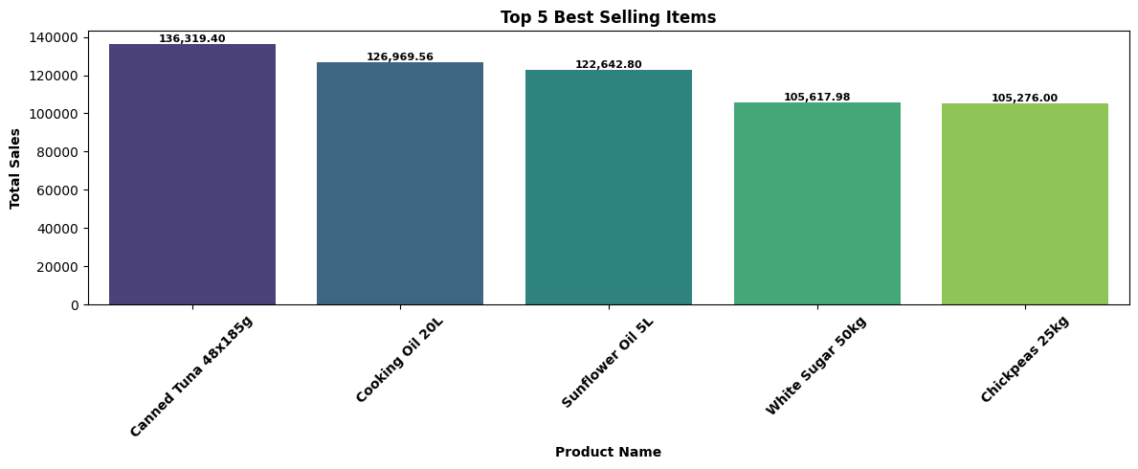
Top items by sales
Revenue is heavily driven by high-frequency, necessity-based products, not discretionary goods. This signals:
Stable baseline demand
Low seasonality risk
High price sensitivity
Action Required: Optimize margins on key items to compete aggressively on price without sacrificing profitability.

Slide 5
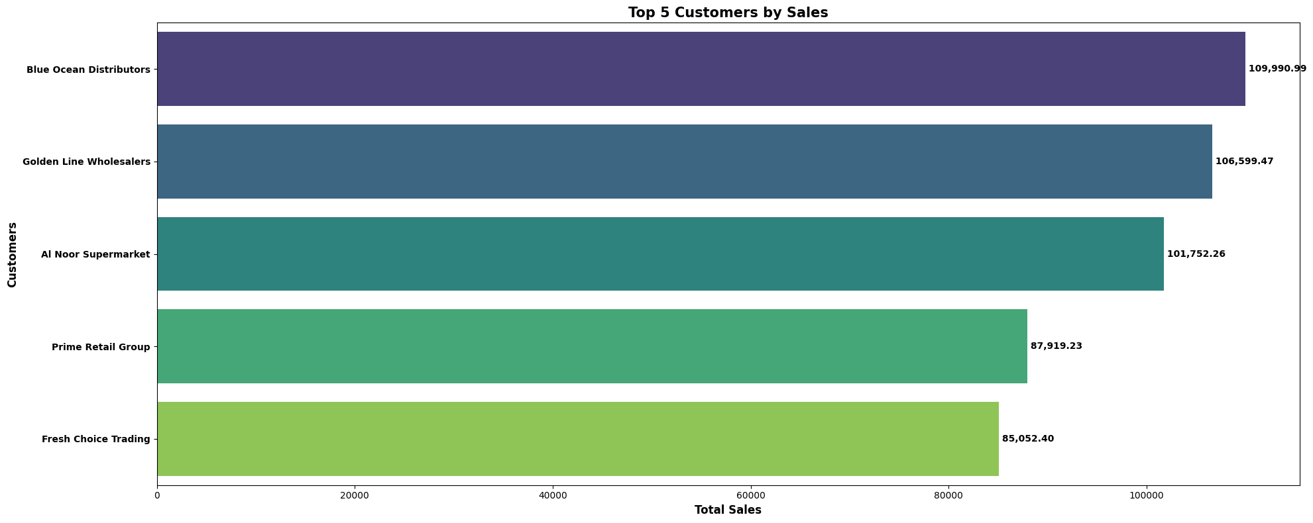
Top customers by sales
• Revenue is heavily concentrated among top-tier customers
Risk: Vulnerability to churn among high-value accounts
Action required: Implement cluster-based product recommendations & accelerate new customer acquisition to diversify revenue base

Slide 6
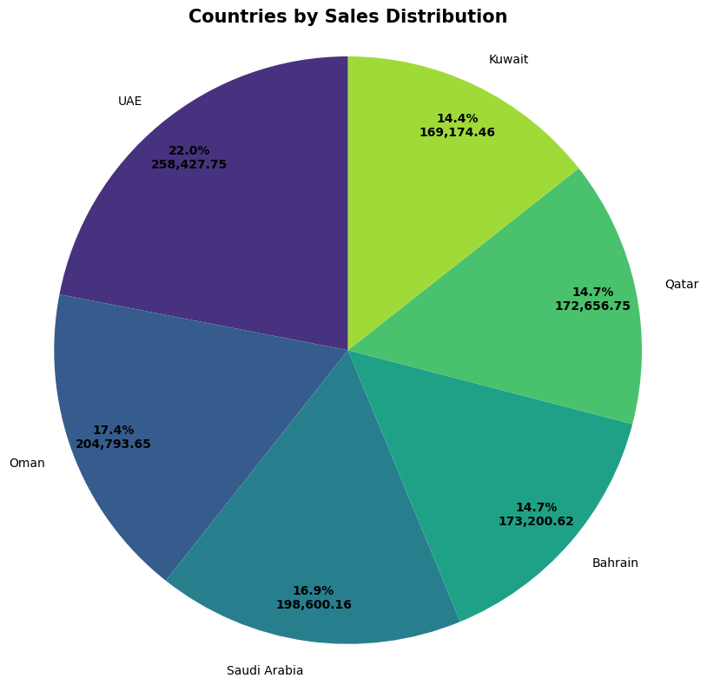
Regional sales distribution
• Regional performance variance not clearly quantified
Action required: replicate success from high-performing regions and diagnose failures in low-performing ones.

Slide 7
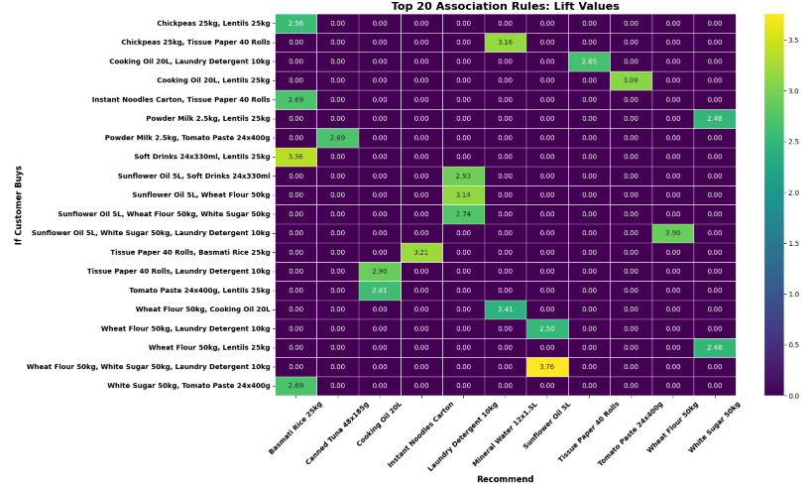
Market Basket Analysis: Which Products Come Together

Slide 8
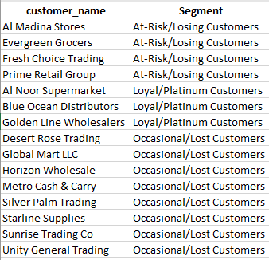
Customer clustering

Slide 9
Cluster-based recommended actions
Loyal / Platinum Customers
Role: Profit Engine Objective: Protect & Maximize LTV
Strategic Actions
VIP loyalty tier & exclusives
Premium cross-sell bundles (MBA-driven)
Early access to new launches
Minimize unnecessary discounting
At-Risk Customers
Role: Revenue at Risk Objective: Reactivate & Prevent Churn
Strategic Actions
Trigger-based win-back campaigns
Personalized offers from past baskets
Limited-time incentives
Churn cause analysis
Occasional / Lost Customers
Role: Selective Growth Opportunity Objective: Increase Engagement or Optimize Spend
Strategic Actions
Entry-level bundles
Automated nurture campaigns
Frequency-building offers
Reduce spend on low-potential users

Slide 10
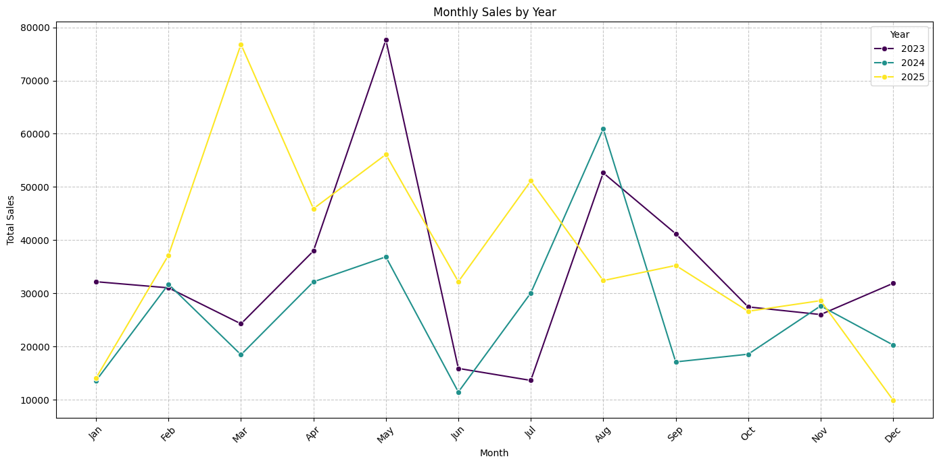
Monthly sales by year
Key Observations:
Structural peaks: March–May and August
June underperforms consistently across all three years
2025 shows strong Q1 acceleration, but weaker Q4 finish
Revenue volatility increasing year-over-year

Slide 11
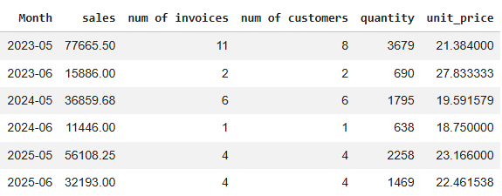
Root cause analysis (why did sales decline in June in all three years?)
June shows volume collapse. Analysis suggests the June dip is a post-promotional slump. Heavy discounting in March–May depletes demand and conditions customers to only buy on sale.
Action Required:
Promotions affecting quantity by recommending complimentary products at promotive prices

Slide 12
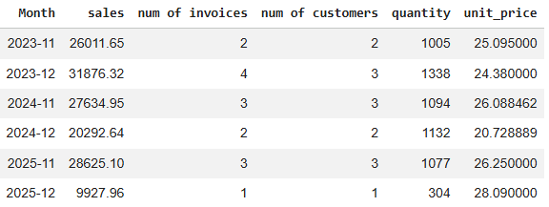
Root cause analysis (why did sales decline in December in all three years?)
December shows a collapse of number of customers ordering which is is likely due to budget exhaustion and holiday focus. Our B2B clients have spent their yearly budget, and individual buyers are focused on personal/family time, not our product category.
Action Required:
End-of-The-Year promotions
Diversifying the customer base by expanding presence in public exhibitions

